Slide 1


Computational Modeling in Human-Computer Interaction
March 9, 2019
CONTACT
Kihwan Kim

Slide 2

2
CONTENTS
Applications of RL
Computational Modeling in HCI
Trends
Inverse RL
MDP
Study plan

Slide 3
3
Applications of RL
게임
대전게임에서 상대해주는 에이전트
게임 레벨 컨트롤
제어
차량의 거동 결정(차선을 바꾸고 싶은 지, 핸들을 틀고 싶은 지)
공장 로봇 자동화
사람의 업무를 보조하는 로봇
의수나 근육보조로봇
서비스 로봇
자연어처리
챗봇의 좀 더 자연스러운 대화
비전
Object tracking
Segmentation 보조하는 에이전트
추천
실시간으로 사용자의 상황에 따라 추천(피드 추천, 광고 추천)
최적화
데이터센터 에너지 최적화
최적 설계
Task scheduling
Neural Architecture Search

Slide 4
4
Computational Modeling in HCI - Trends
[Inverse RL]
Nikola Banovic, Anqi Wang, Yanfeng Jin, Christie Chang, Julian Ramos, Anind Dey, and Jennifer Mankoff. 2017. Leveraging Human Routine Models to Detect and Generate Human Behaviors. In Proceedings of the 2017 CHI Conference on Human Factors in Computing Systems (CHI '17). ACM, New York, NY, USA, 6683-6694.
Nikola Banovic. 2018. Modeling and Predicting Rehospitalization. In Computational Method for Understanding Complex Human Routine Behaviors. Ph.D. Dissertation. Carnegie Mellon University, Pittsburgh, PA, USA.
Nikola Banovic, Tofi Buzali, Fanny Chevalier, Jennifer Mankoff, and Anind K. Dey. 2016. Modeling and Understanding Human Routine Behavior. In Proceedings of the 2016 CHI Conference on Human Factors in Computing Systems (CHI '16). ACM, New York, NY, USA, 248-260.
Nikola Banovic, Anqi Wang, Yanfeng Jin, Christie Chang, Julian Ramos, Anind Dey, and Jennifer Mankoff. 2017. Leveraging Human Routine Models to Detect and Generate Human Behaviors. In Proceedings of the 2017 CHI Conference on Human Factors in Computing Systems (CHI '17). ACM, New York, NY, USA, 6683-6694.
[POMDP]
Andrew Howes, Xiuli Chen, Aditya Acharya, and Richard L. Lewis. 2018. Interaction as an Emergent Property of a Partially Observable Markov Decision Process. In Computational Interaction, edited by Antti Oulasvirta, Per Ola Kristensson, Xiaojun Bi, and Andrew Howes. Oxford: Oxford University Press, 2018.

Slide 5
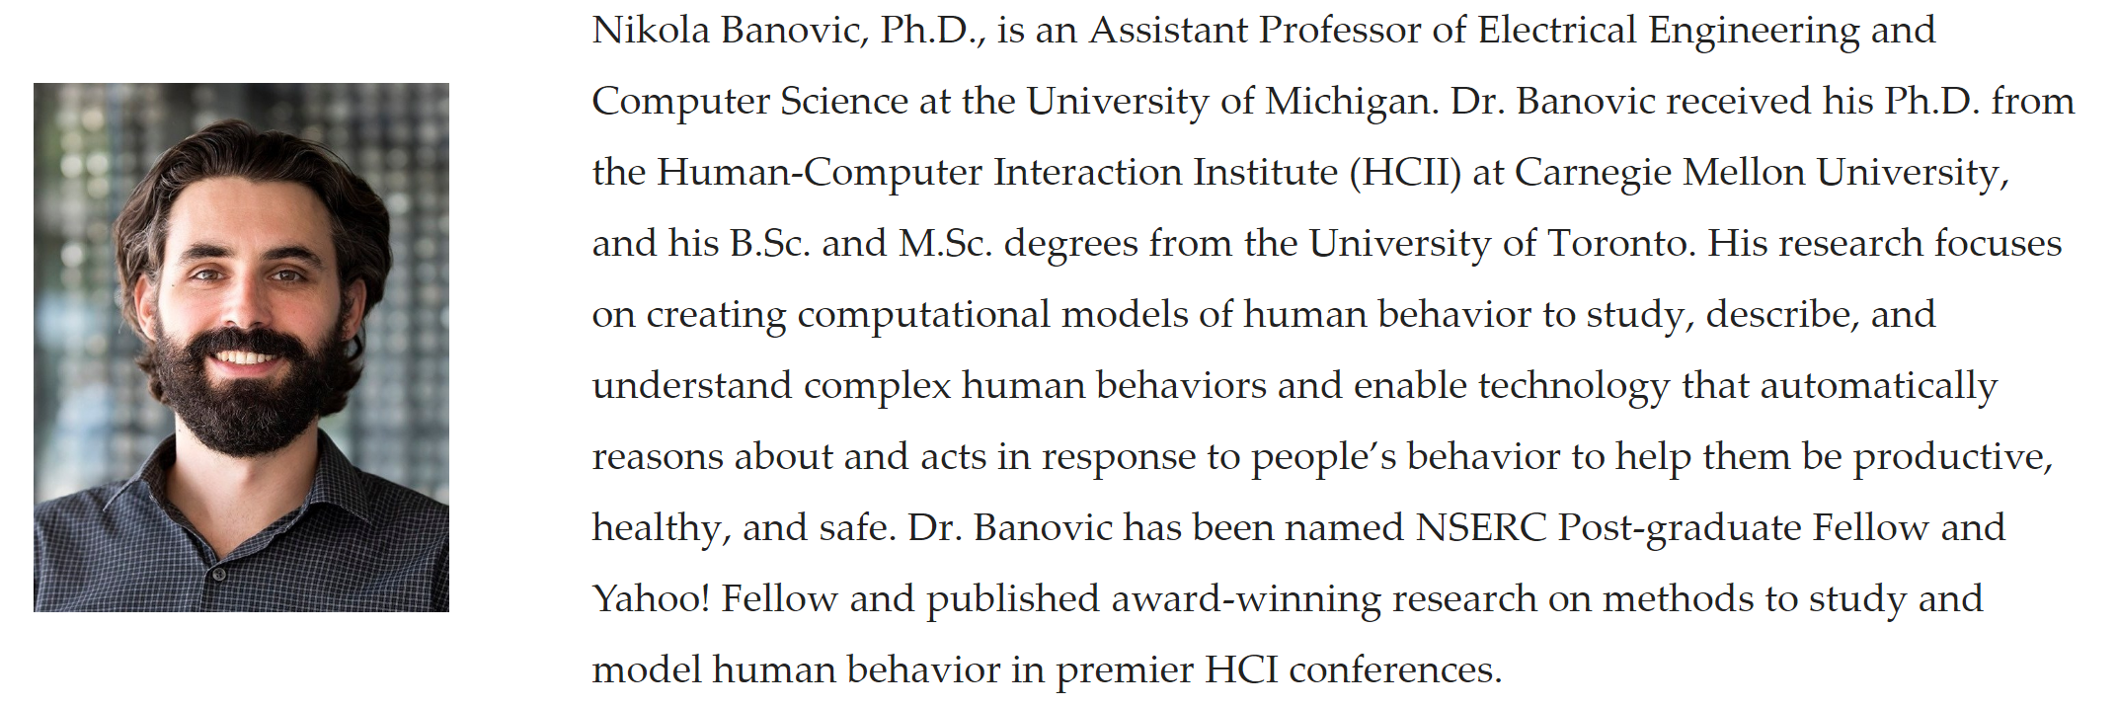
5
Computational Modeling in HCI - Trends
[ACM-CHI-2019-Workshop] https://hcicompmodeling.wordpress.com/
[Seminar-Course] http://www.nikolabanovic.net/EECS_598_Computational_Modeling_HCI

Slide 6
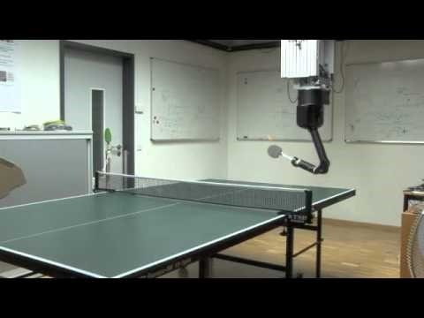
6
Computational Modeling in HCI - IRL

Slide 7
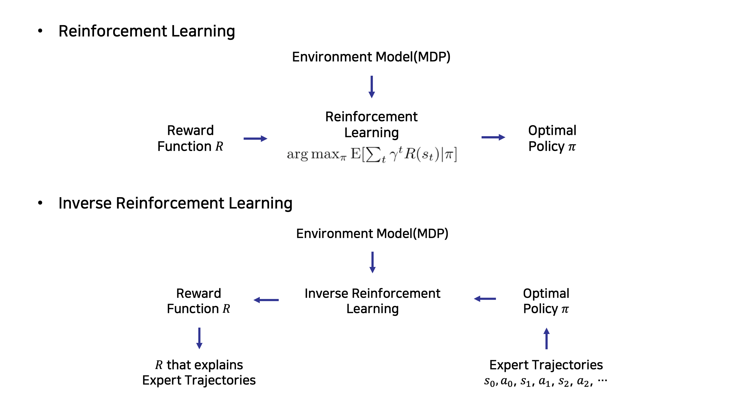
6
Computational Modeling in HCI - IRL

Slide 8
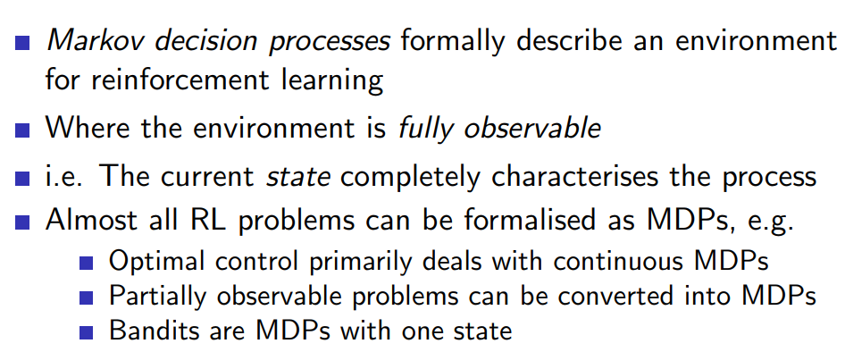
7
Computational Modeling in HCI - MDP

Slide 9
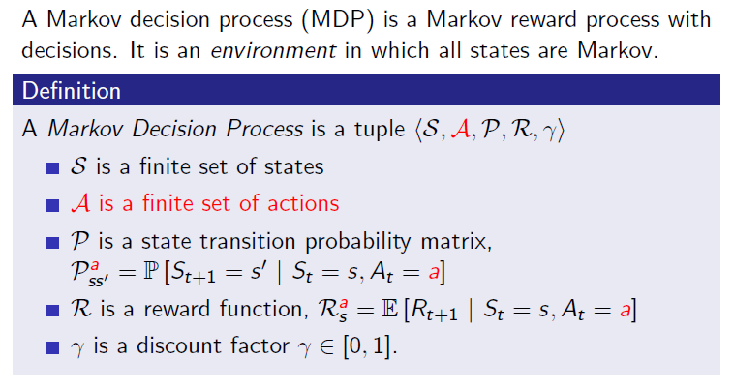
8
Computational Modeling in HCI - MDP

Slide 10
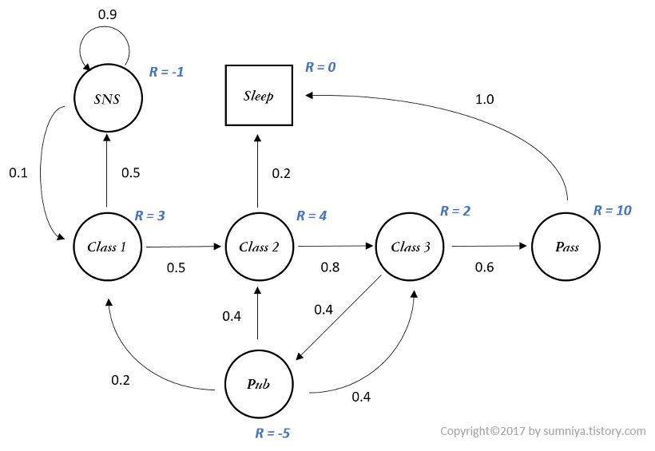
9
Computational Modeling in HCI - MDP
Explainable & Interpretable

Slide 11
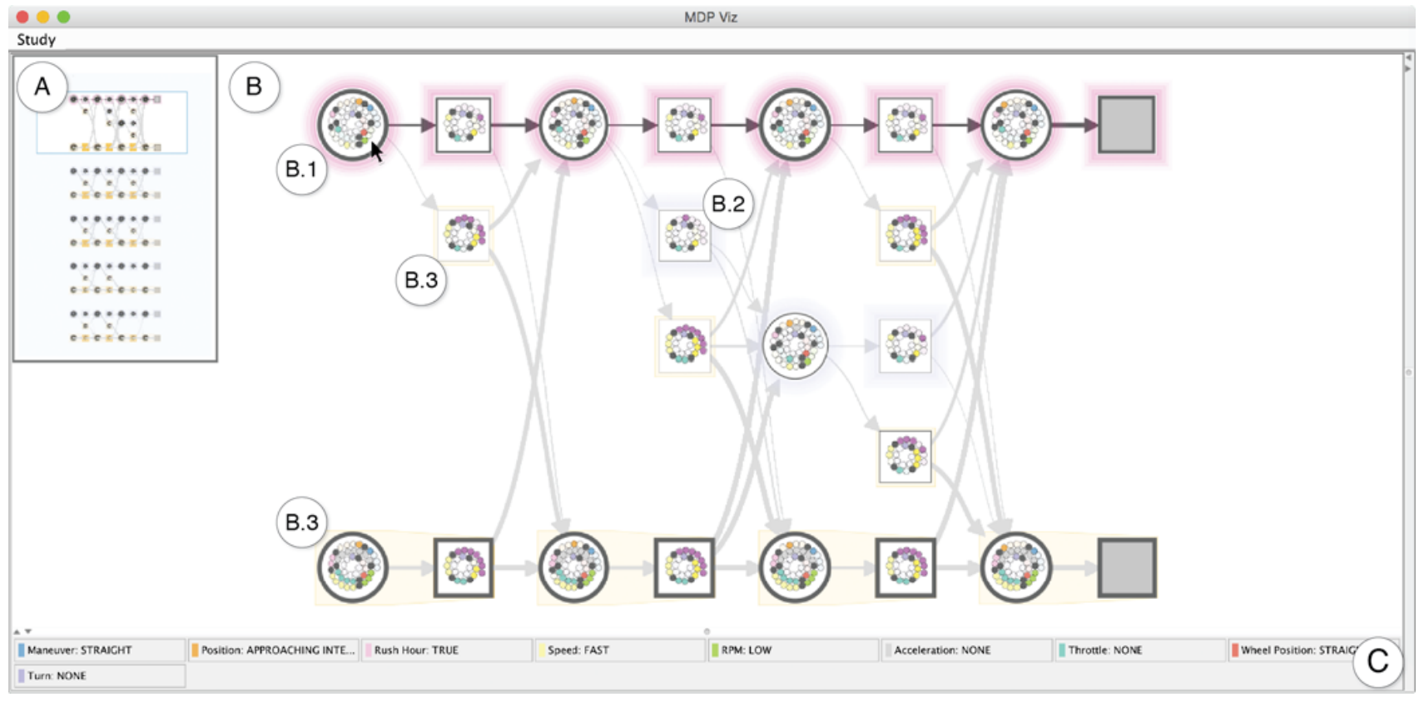
10
Computational Modeling in HCI - MDP
Explainable & Interpretable
Nikola Banovic, Tofi Buzali, Fanny Chevalier, Jennifer Mankoff, and Anind K. Dey. 2016. Modeling and Understanding Human Routine Behavior. In Proceedings of the 2016 CHI Conference on Human Factors in Computing Systems (CHI '16). ACM, New York, NY, USA, 248-260.

Slide 12
11
Study plan
모두를 위한 딥러닝 – Deep Reinforcement Learning [Current]
(OpenAI) Spinning Up in Deep RL
a short introduction to RL terminology, kinds of algorithms, and basic theory
a curated list of important papers organized by topic
a well-documented code repo of short, standalone implementations of key algorithms
(RLKorea) Let's do Inverse RL Guide
https://reinforcement-learning-kr.github.io/2019/01/22/0_lets-do-irl-guide/
[Linear IRL] Algorithms for Inverse Reinforcement Learning
[APP] Apprenticeship Learning via Inverse Reinforcement Learning
[MMP] Maximum Margin Planning
[MaxEnt] Maximum Entropy Inverse Reinforcement Learning
[GAIL] Generative Adversarial Imitation Learning
[VAIL] Variational Discriminator Bottleneck: Improving Imitation Learning, Inverse RL, and GANs by Constraining Information Flow
Find and read papers at the intersection of Inverse RL and HCI.
[MaxCausalEnt] Modeling Interaction via the Principle of Maximum Causal Entropy
[Seminar-Course] http://www.nikolabanovic.net/EECS_598_Computational_Modeling_HCI

